Slide 1




Bayesian Networks and Synthetic Data Generation for Subsistence Retail Analytics:
GROUP 4:
ASSESSOR:
MLAMBO MICHELLE - 2019054895
MHLAULI AYANDA - 2021442765
Dr. Herkulaas MvE Combrink.
Dr. Nyashadzashe Tamuka.
Miss. Valusha Oelofse .
EDAB6808 | University of the Free State | October 2025
Notes:
Good day everyone. Today I’m presenting our project on leveraging Bayesian networks and synthetic data generation to predict purchase intentions in the Soweto subsistence retail sector

Slide 2
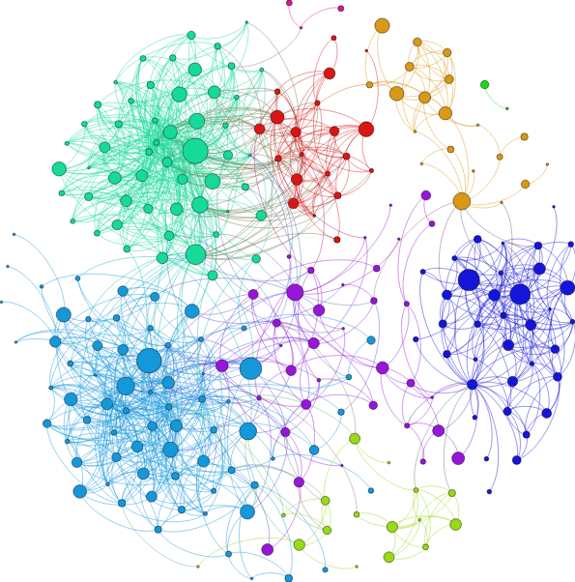
OBJECTIVE:
To evaluate and compare the effect of data balancing and synthetic data generation on Bayesian Network models for predicting Purchase Intention (PI) using the Soweto subsistence retail dataset.
01/ 13
Notes:
Our main goal is to evaluate and compare how different data balancing and synthetic data methods affect the predictive power of Bayesian networks in modeling purchase intentions. The analysis uses the Soweto dataset, which encompasses demographic and behavioural data for over 280 respondents.

Slide 3
Dataset Overview
Demographic Variables
Gender
Male
Female
Age
18–22
Marital Status
Employment Status
Level of Education
Regular Customer
Shopping Frequency
23–28
Prefer not to say
29–35
35–49
50–65
Married
Single
Prefer not to say
Employed
Unemployed
No formal education
Basic education
Diploma
Degree
Postgraduate degree
Regular
Need-based
1–2 times per week
2–3 times per week
3–4 times per week
5–6 times per week
6–7 times per week
Measurement Instruments
Empathy
Convenience
Price Sensitivity
Physical Environment
Perceived Product Quality
Customer Trust
Purchase Intention
Perceived Value
Purchase Intention
Likert Scale
Strongly Disagree
Disagree
Strongly Agree
Agree
Neutral
02/ 13
Notes:
Our subsistence retail dataset consists of 281 consumers from Soweto, captured across 41 variables—including 7 demographic types and 30 measurement constructs like empathy, product quality, and perceived value. These constructs were measured on five-point Likert scales and show consistent distribution patterns.
We observe almost perfect parity in gender, with males and females split about evenly, and coverage across a wide age and education spectrum. Most shoppers are regular customers who shop 1-2 times a week, with basic education being most common.
The core outcomes, our four purchase intention targets, are distributed in a heavily imbalanced way—most respondents choose 'Agree,' indicating loyalty and intent to repurchase. Minority classes (Disagree, Strongly Disagree) are underrepresented, which poses a challenge for predictive modeling and motivates our use of balancing and synthetic data generation methods.
Overall, the EDA highlights rich construct diversity, realistic demographic spread, and a critical imbalance in purchase intentions, providing robust context for model building and fairness-driven analytics

Slide 4
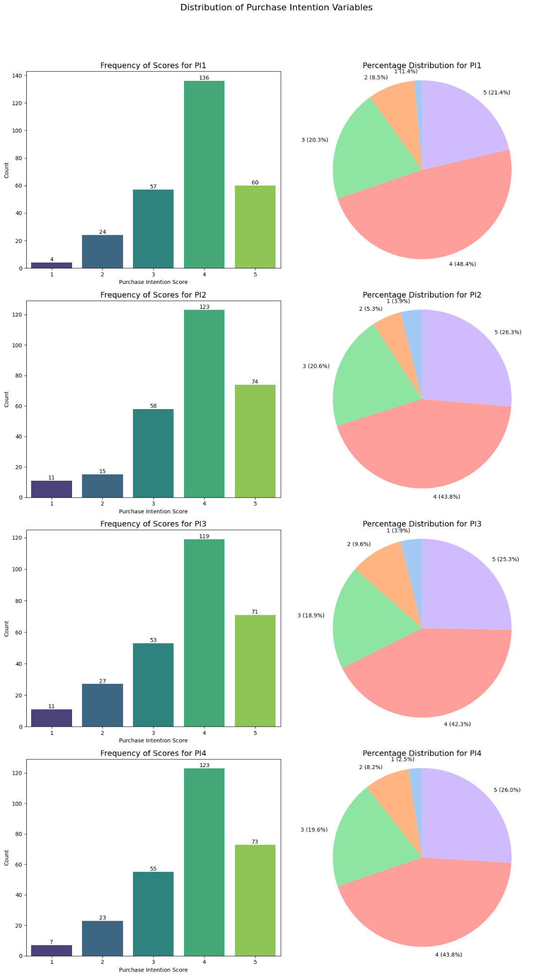
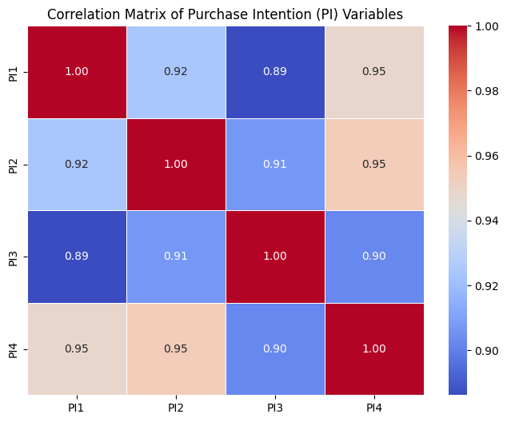
Dataset Overview
Purchase Intention (PI1–PI4) distributions are strongly skewed.
Most respondents choose “Agree” or “Strongly Agree” over 65% of responses for each PI.​
Rare responses (“Disagree”, “Strongly Disagree”) consistently make up less than 10%, showing heavy class imbalance.
This skew means typical predictive models may struggle to learn minority class patterns.
All PI variables are statistically correlated.
Correlation coefficients between PI1–PI4 are high, indicating responses to one PI are linked to the others.
This correlation reflects that consumers who are likely to repurchase or recommend also show strong intention to purchase and endorse
03/ 13
Notes:
Our subsistence retail dataset consists of 281 consumers from Soweto, captured across 41 variables—including 7 demographic types and 30 measurement constructs like empathy, product quality, and perceived value. These constructs were measured on five-point Likert scales and show consistent distribution patterns.
We observe almost perfect parity in gender, with males and females split about evenly, and coverage across a wide age and education spectrum. Most shoppers are regular customers who shop 1-2 times a week, with basic education being most common.
The core outcomes, our four purchase intention targets, are distributed in a heavily imbalanced way—most respondents choose 'Agree,' indicating loyalty and intent to repurchase. Minority classes (Disagree, Strongly Disagree) are underrepresented, which poses a challenge for predictive modeling and motivates our use of balancing and synthetic data generation methods.
Overall, the EDA highlights rich construct diversity, realistic demographic spread, and a critical imbalance in purchase intentions, providing robust context for model building and fairness-driven analytics.

Slide 5
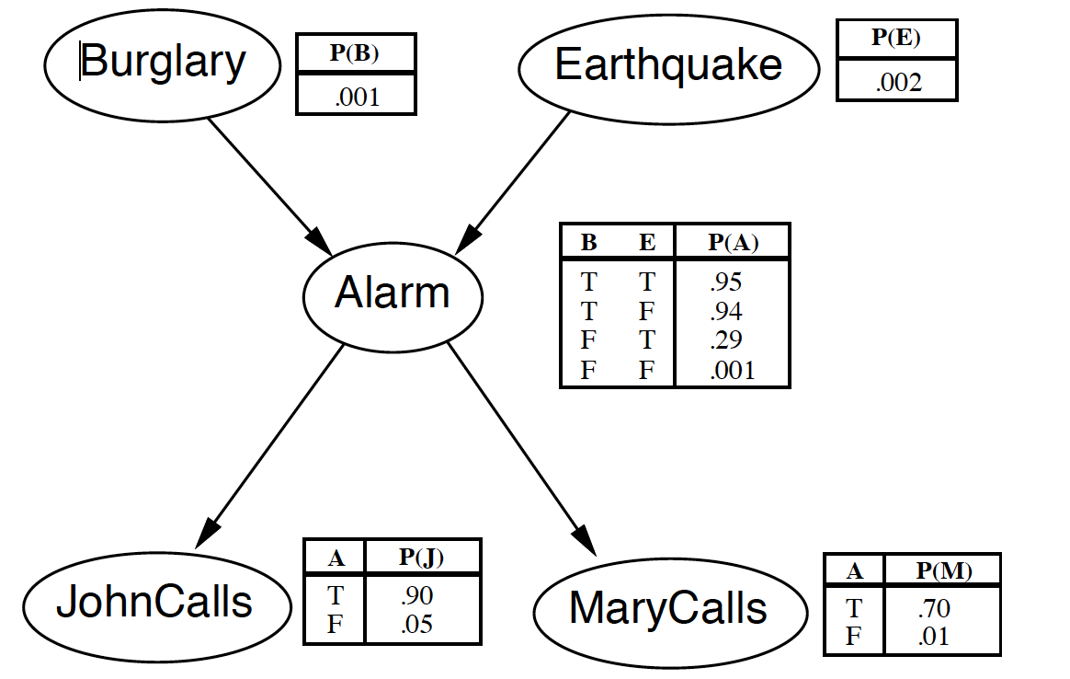
Bayesian Networks (BN)
Bayesian networks are graphical probabilistic models that represent variables and their conditional dependencies (Derks et al., 2020).
They support causal reasoning and help quantify uncertainty in consumer decision-making (RMB, 2019).
The models integrate both measured data and expert knowledge to improve prediction robustness
Bayesian networks are highly interpretable—users can explicitly see how predictors like price sensitivity affect purchase intentions (GeeksForGeeks, 2024).
Practical advantages include strong performance with missing/incomplete data and small retail samples (Shelf.io, 2024).
Widely used for scenario analysis, purchase prediction, and market strategy in retail settings
04/ 13
Notes:
A Bayesian network is a probabilistic graphical model that visually describes how variables are causally connected and what uncertainties exist in those relationships. B ayesian networks visualize complex relationships and uncertainties in consumer behaviour. This network structure lets us reason not just with raw data, but also to incorporate expert knowledge—for example, known patterns in consumer behaviour. Bayesian networks are valued in retail analytics because they’re highly interpretable: we can literally see how factors like price sensitivity or perceived value affect purchase likelihood. They’re effective even when data is missing or sample sizes are small, providing robust probability-based predictions when other models may fail. With Bayesian networks, we’re able to conduct detailed scenario analysis and simulate the effect of changing different variables—making these models uniquely powerful for purchase intention prediction and strategic planning in retail.

Slide 6
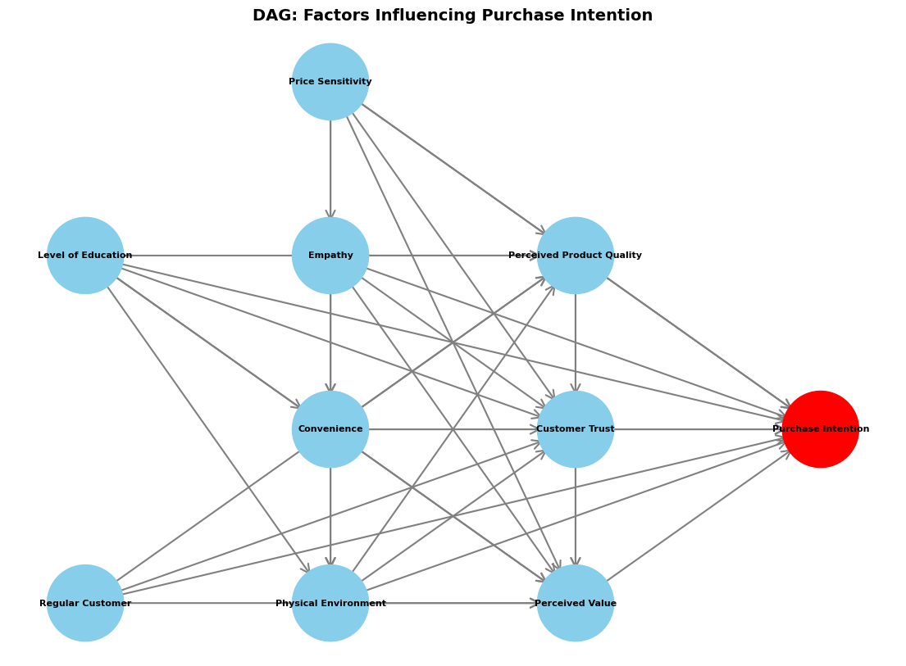
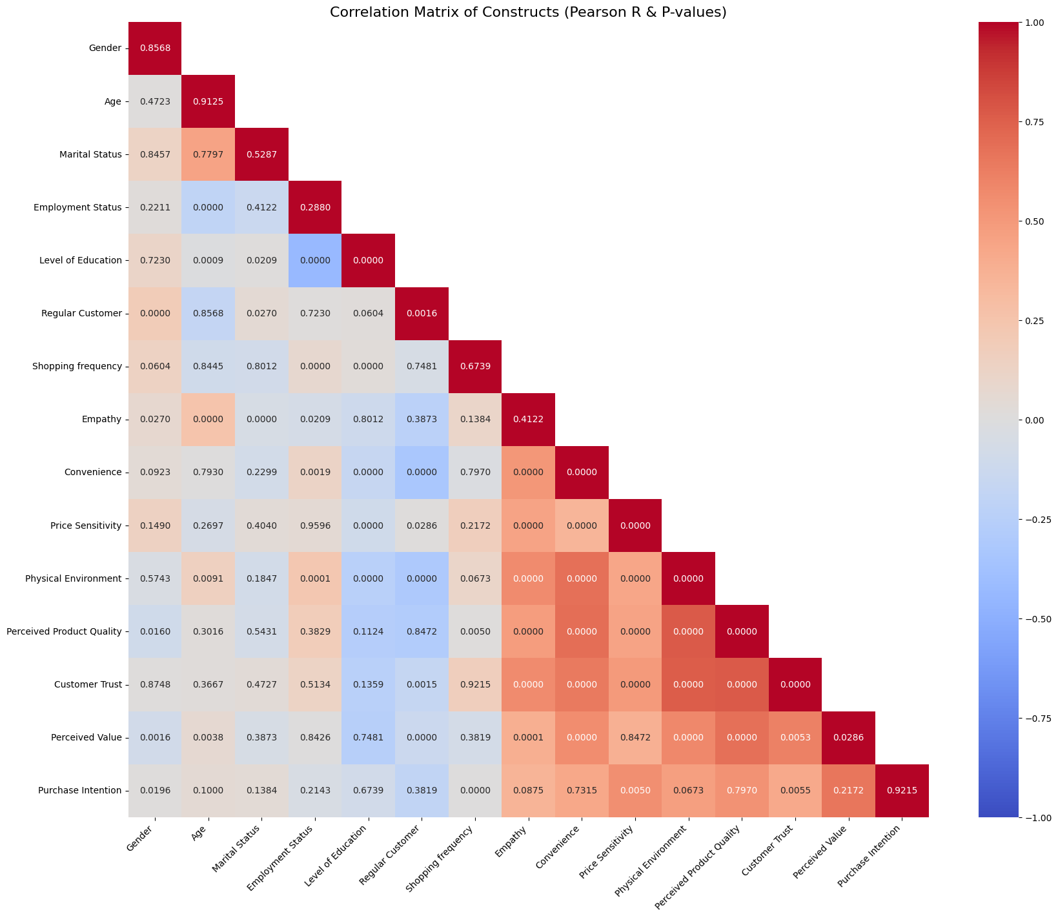
Overall Model
WHAT WAS THE INSPIRATION:
WHY DID IT NOT PRODUCE IDEAL RESULTS?
05/ 13

Slide 7
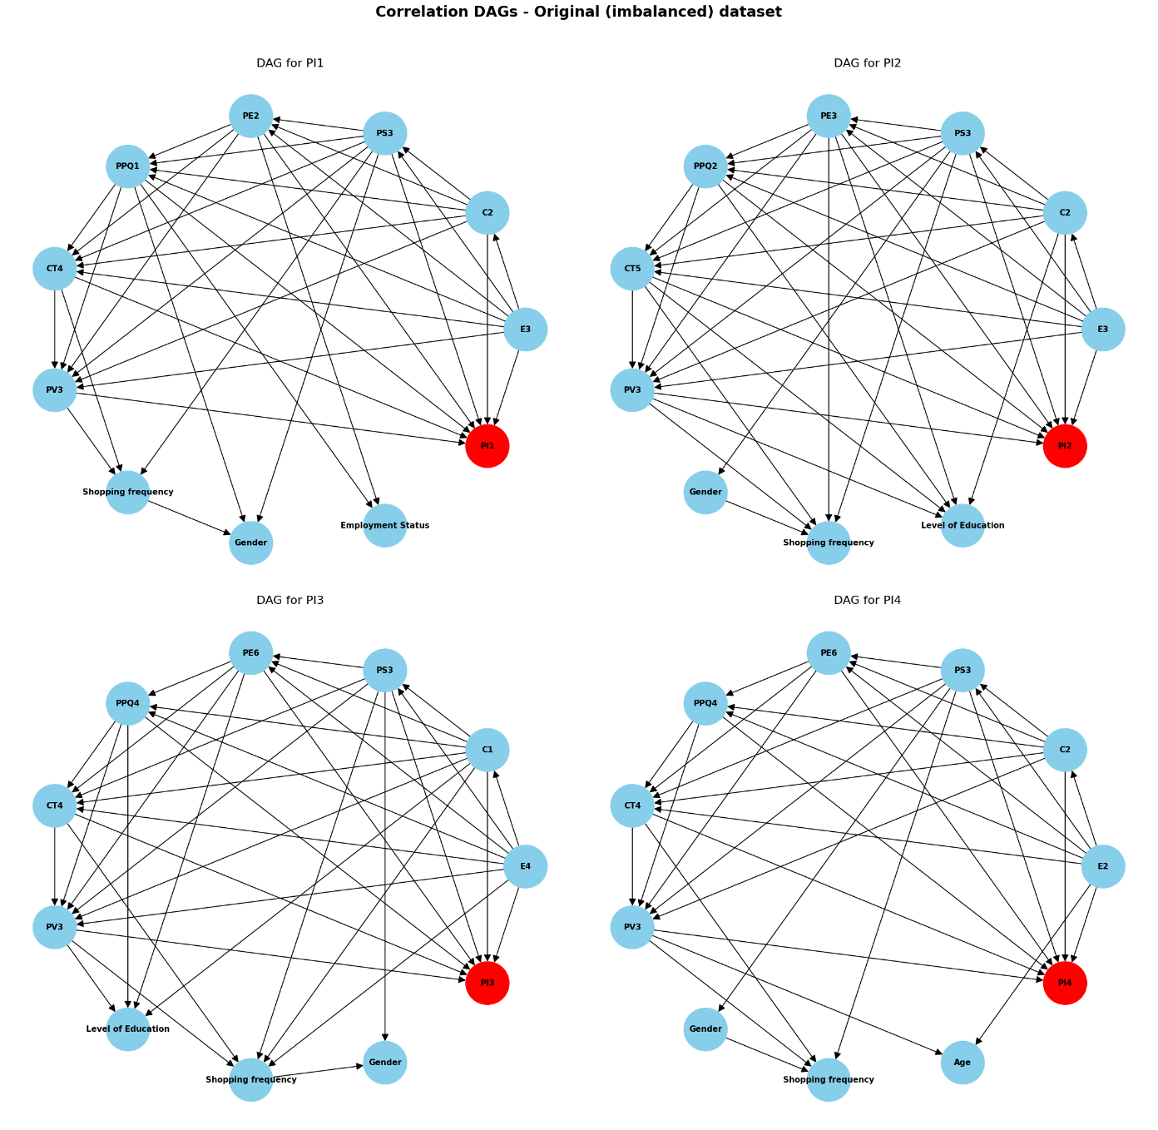
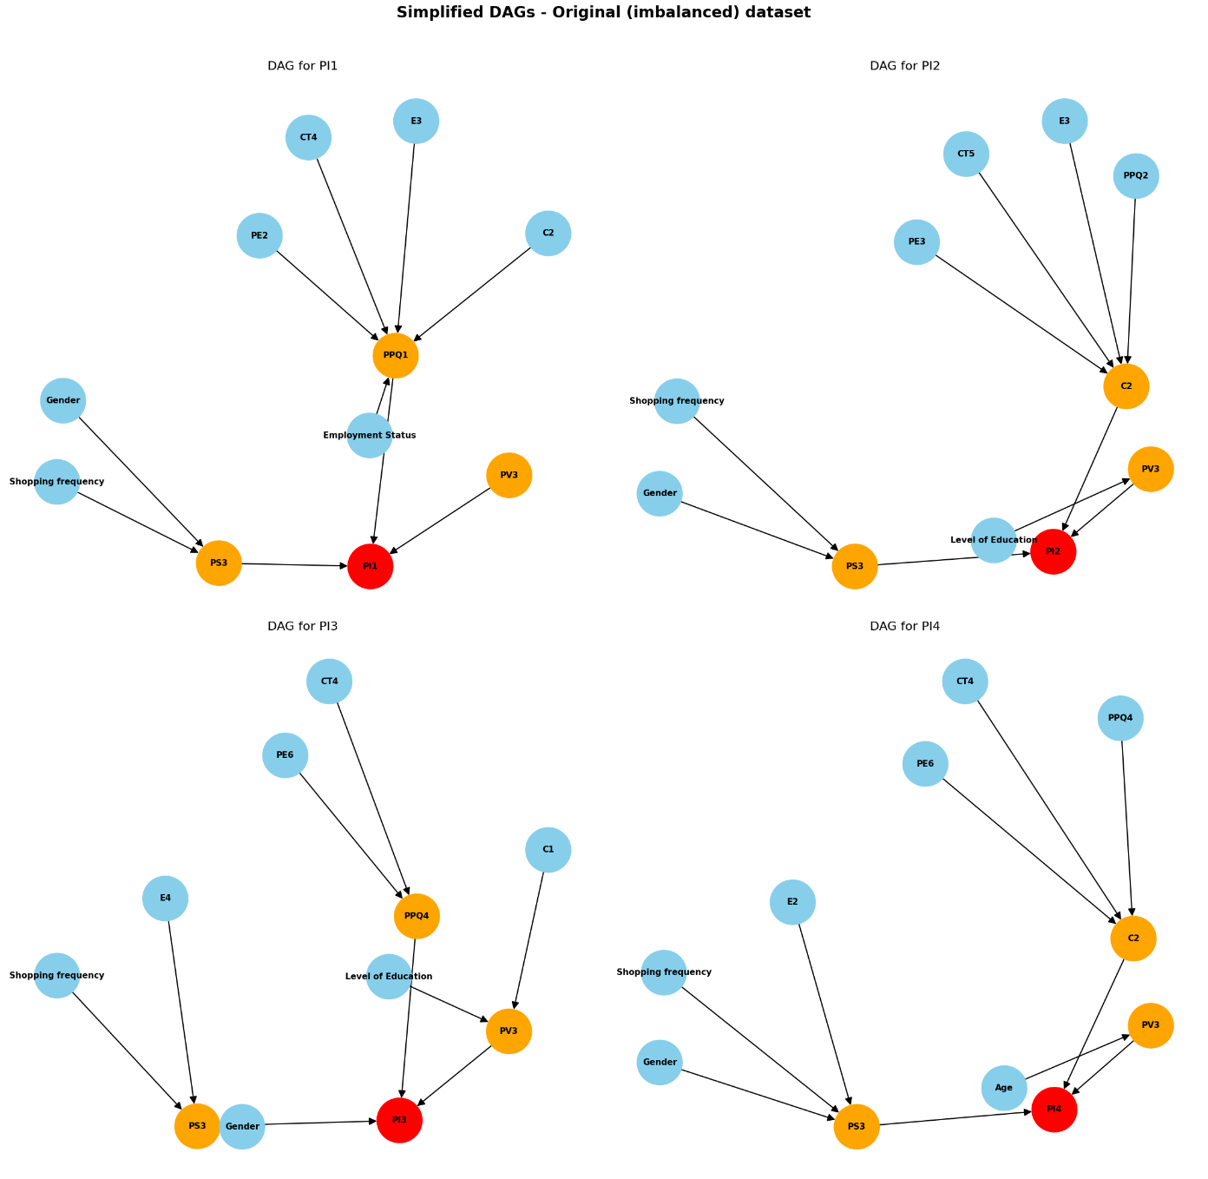
Building a BN DAG
Why Feature Selection?
Overfitting
Computational cost
Interpretability loss
Selection Strategy
For each PI, we select 10 features:
7 Measurement features
3 Demographic features
Methods
Random Forest Feature Importance
Correlation Analysis
P-value Testing
06/ 13
Notes:
When modelling with Bayesian networks, feature selection is essential due to the complexity and size of our data. With 37 possible predictors, including demographic and psychometric variables, we face three key risks if we include everything:
First, the model might overfit: it could memorize the training data rather than learn patterns that generalize to new consumers.
Second, computational costs become an issue, because Bayesian networks are much slower and more difficult to estimate as the number of nodes grows.
Third, interpretability suffers. Complex networks with too many variables are nearly impossible to explain or visualize for stakeholders.
To address these risks, we developed a disciplined feature selection strategy for each purchase intention variable. Specifically, we limited each Bayesian network to just 10 predictors:
Seven were core measurement features—one from each key construct: Empathy, Convenience, Price Sensitivity, Physical Environment, Product Quality, Trust, and Value.
The other three were chosen from the most predictive demographic features.
For the methods, we combined:
Random Forest feature importance, to identify which predictors have the most impact on the model performance.
Correlation analysis, to ensure no two features are redundant with each other—using a threshold of 0.85 to filter out highly-correlated variables.
And p-value testing, so only statistically significant features (alpha 0.05) are included.
This three-part selection process guarantees balanced model design by ensuring all core constructs are represented, all features are significant and non-redundant, and the network remains interpretable and computationally manageable. Ultimately, this approach leads to more reliable, clear, and actionable Bayesian models. We defined edges—how the features connect to purchase intention—using two approaches:
The first is correlation-based: we add edges only where the p-value is less than 0.05, making sure relationships are statistically significant, but noting there’s a risk of spurious links from the data.
The second is a simplified, hierarchical method: the three most highly-correlated features link directly to purchase intention, while other features connect to their closest top predictor. This creates interpretable, sparse networks that are easier to explain (Derks et al., 2020).
This two-pronged approach balances data-driven rigor and practical interpretability.

Slide 8

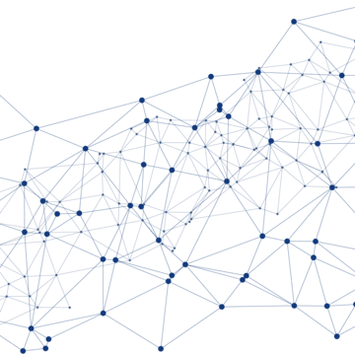
Original (imbalanced) dataset
Performance Simplified
Performance Correlation
Model | Accuracy | Precision | Recall | F1 Score
PI1 | 0.882 | 0.956 | 0.882 | 0.907
PI2 | 0.647 | 0.757 | 0.647 | 0.679
PI3 | 0.718 | 0.847 | 0.718 | 0.756
PI4 | 0.776 | 0.854 | 0.776 | 0.801
Model | Accuracy | Precision | Recall | F1 Score
PI1 | 0.753 | 0.782 | 0.753 | 0.757
PI2 | 0.624 | 0.624 | 0.624 | 0.624
PI3 | 0.647 | 0.647 | 0.647 | 0.647
PI4 | 0.765 | 0.765 | 0.765 | 0.765
07/ 13
Notes:
Our starting point was to develop baseline Bayesian Network models for each of the four purchase intention (PI) variables, using the original imbalanced Soweto subsistence retail dataset.
For each purchase intention, the network includes a total of ten predictors:
Seven measurement constructs were selected: Empathy, Convenience, Price Sensitivity, Physical Environment, Product Quality, Customer Trust, and Perceived Value.
Three demographic variables were chosen based on feature importance analysis, and they differ per PI model—covering gender, age, education, employment status, and shopping frequency.
Let me briefly outline the features for each model:
For PI1, ‘I intend to purchase from this grocery store’, our predictors included perceptions of staff empathy, store layout, price sensitivity, cleanliness, trust, product quality, and perceived value, plus shopping frequency, gender, and employment status.
For PI2, ‘I would like to repeat my experience’, we included similar constructs, but the physical environment was measured by aisle width, and demographic predictors included gender, shopping frequency, and level of education.
PI3, ‘I would purchase from this grocery store in the future,’ featured efficiency of staff, ease of finding products, perceived safety, bakery quality, and demographic details like education, shopping frequency, and gender.
For PI4, ‘I would recommend this grocery store to others’, the model included perception of being understood by the store, safe environment, and age as a key demographic, alongside other common predictors.
Across all models, each PI network incorporates both core retail constructs and the most influential demographics, creating a robust and interpretable baseline for purchase intention modeling.
These selections serve as the foundation for the network’s structure learning and probabilistic inference, leveraging the full power of Bayesian networks to capture the diverse range of factors influencing customer purchase intentions—even before we apply any balancing or data augmentation methods.

Slide 9
Synthetic Data Generation
Objective: Balance each Purchase Intention (PI1–PI4) variable for fair Bayesian modelling.
Methods Used:
SMOTE (Synthetic Minority Oversampling Technique)
ML-based Imputation (KNN)
GAN (Generative Adversarial Networks for Tabular Data)
Why Balancing is Needed:
Each PI variable (Likert 1–5) is heavily imbalanced (Majority class: ~120–136, Minority: 4–11).
Imbalance causes overfitting and poor minority recall.
Multi-Target Challenge:
4 correlated PI variables require separate balancing.
Option A: One merged balanced dataset (failed—creates duplication, loss of independence, artifacts).
Option B: Four separate datasets, each optimized for one PI (used—ensures validity, no cross-contamination).
Implementation:
12 total Bayesian models trained (original, SMOTE, KNN, GAN × 4 PI targets).
Each synthetic method creates a validated, balanced target dataset.
08/ 13
Notes:
We needed to address a fundamental limitation in our dataset—each purchase intention variable (PI1–PI4), measured on a 1–5 scale, showed severe class imbalance, with most respondents choosing class 4 and very few choosing lower ratings. This imbalance leads to models heavily favoring the majority class and missing rare but meaningful minority patterns.
To solve this, we applied three synthetic data generation methods: SMOTE, which uses interpolation; ML imputation via K-nearest neighbors; and Generative Adversarial Networks for tabular data. Our challenge was unique because the PI variables are statistically correlated and need to be balanced separately for fair modeling.
We tested two approaches:
First was a single combined synthetic dataset. This approach failed—it caused duplication explosions, unrealistic data artifacts, and chaotic distributions due to ignoring dependencies between the PI variables.
The only valid solution was to create four distinct datasets, each perfectly balanced for one PI target while treating the other PIs as auxiliary features. This approach respects variable dependencies and aligns with sound statistical reasoning.
Ultimately, this strategy allowed us to train 12 separate Bayesian networks—one for each dataset and method—yielding balanced, interpretable, and statistically robust models. The key lesson is that multi-target imbalanced learning strictly requires task-specific datasets to avoid data corruption and misleading results.

Slide 10
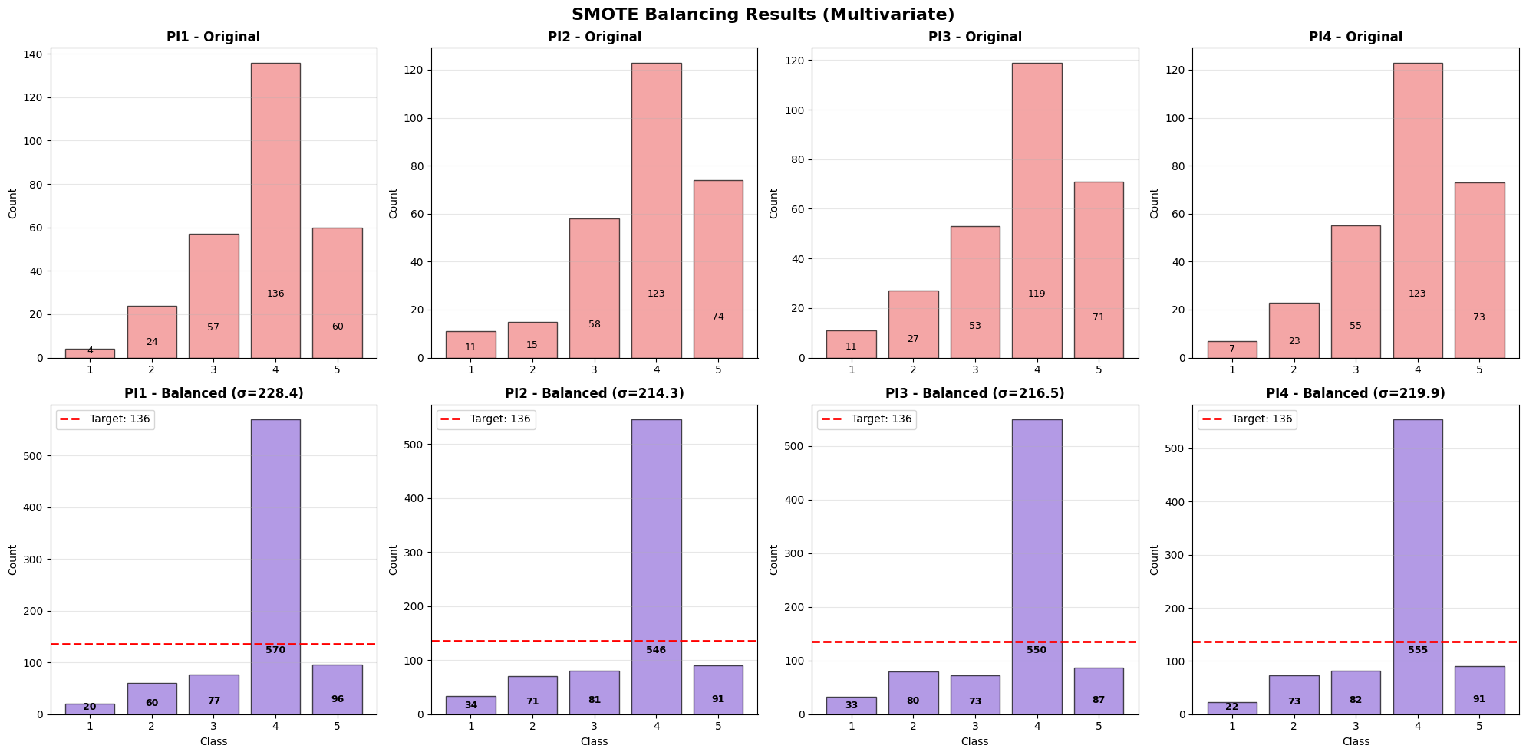
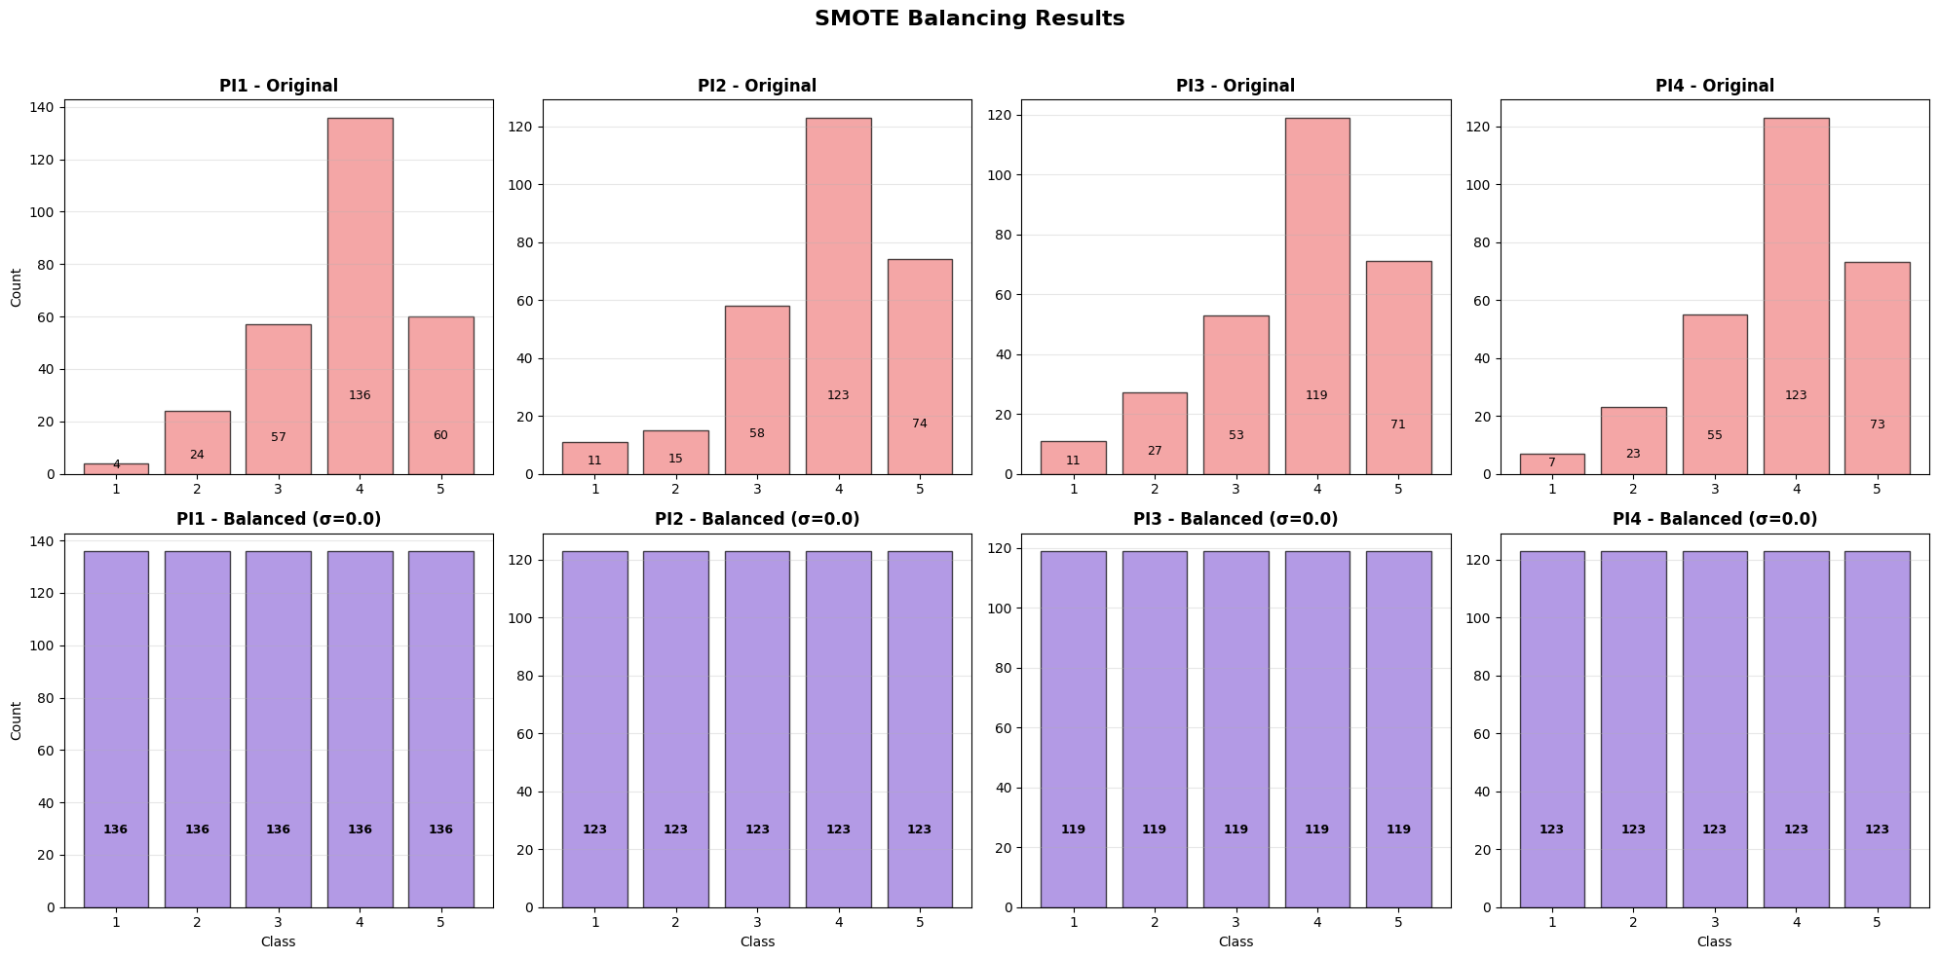
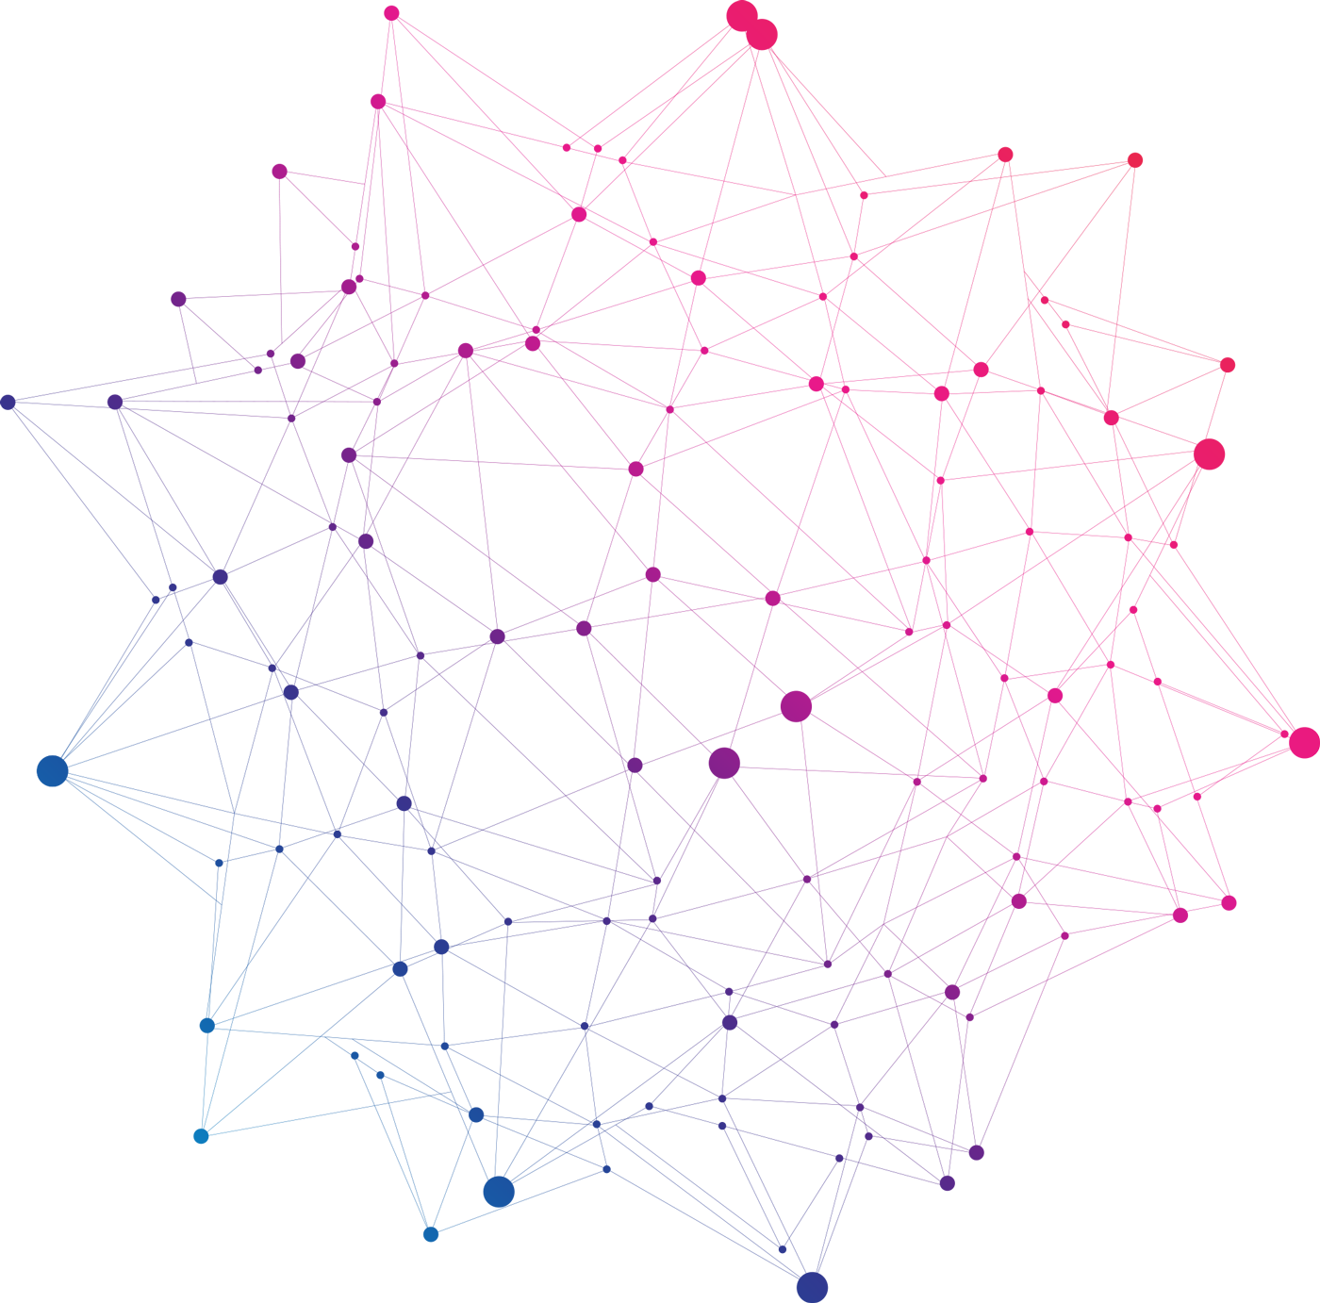
SMOTE: Synthetic Data
Algorithm for balancing imbalanced datasets (Chawla et al., 2002). Generates synthetic samples by interpolating between existing minority class examples
Model | Accuracy | Precision | Recall | F1 Score
PI1 | 0.668 | 0.668 | 0.668 | 0.668
PI2 | 0.583 | 0.583 | 0.583 | 0.583
PI3 | 0.652 | 0.652 | 0.652 | 0.652
PI4 | 0.607 | 0.607 | 0.607 | 0.607
Model | Accuracy | Precision | Recall | F1 Score
PI1 | 0.765 | 0.765 | 0.765 | 0.765
PI2 | 0.719 | 0.719 | 0.719 | 0.719
PI3 | 0.682 | 0.682 | 0.682 | 0.682
PI4 | 0.692 | 0.692 | 0.692 | 0.692
09/ 13
Notes:
SMOTE, or Synthetic Minority Oversampling Technique, is a widely-used algorithm for solving class imbalance by generating new synthetic samples for the minority classes. Instead of simply duplicating rare examples, SMOTE generates novel data points by interpolating between k-nearest neighbors of the minority class in feature space (Chawla et al., 2002).
For our purchase intention problem, this helps create a more balanced training set, allowing the models to learn not just the majority signals, but also rare, significant minority patterns.
SMOTE is simple and effective for tabular, continuous data, but has limitations. It may sometimes generate unrealistic values in sparse regions, and for categorical features, modifications are needed to ensure valid synthetic samples. Despite this, SMOTE remains a preferred tool for combating imbalance in practical machine learning workflows
These results show a clear advantage for the complex, task-specific balancing approach. With the simple approach—where all synthetic samples were merged into a single dataset—we achieved only moderate average accuracy (0.628) and low precision (0.546), largely because of duplication artifacts and corruption of class distributions.
In contrast, the complex approach—using four separate, independently balanced datasets for each PI target—yielded much better results: average accuracy jumped to 0.714, with precision and recall also significantly higher. By isolating the balancing for each target, we avoided the statistical dependencies that plagued the simple method, leading to more realistic and informative models.
The improvement in F1 score from 0.567 to 0.709 demonstrates far better performance in recognizing both majority and minority patterns. This confirms that multi-target synthetic learning should always use separate, optimized datasets for each outcome, especially in settings like retail analytics with correlated behavioral targets.”

Slide 11
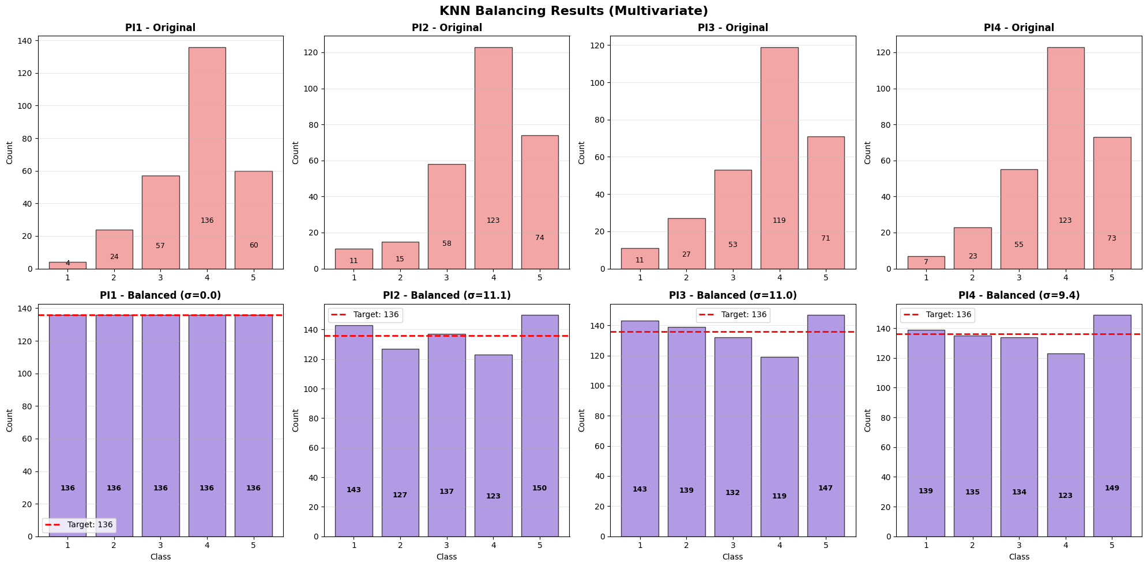

KNN: Synthetic Data
K-nearest neighbors algorithm to generate synthetic minority samples. For each minority instance, finds k most similar (“nearest”) real data points in feature space.
Model | Accuracy | Precision | Recall | F1 Score
PI1 | 0.693 | 0.693 | 0.693 | 0.693
PI2 | 0.601 | 0.601 | 0.601 | 0.601
PI3 | 0.675 | 0.675 | 0.675 | 0.675
PI4 | 0.680 | 0.680 | 0.680 | 0.680
Model | Accuracy | Precision | Recall | F1 Score
PI1 | 0.819 | 0.819 | 0.819 | 0.819
PI2 | 0.751 | 0.751 | 0.751 | 0.751
PI3 | 0.754 | 0.754 | 0.754 | 0.754
PI4 | 0.778 | 0.778 | 0.778 | 0.778
10/ 13
Notes:
KNN-based imputation is an intelligent method for balancing imbalanced classes. Rather than interpolating new points between just two minority samples, KNN examines the k-nearest real neighbors around each instance. Synthetic samples are created by copying and mixing feature values of these neighbors, with added noise for more diversity.
This approach is powerful because it preserves realistic clustering and structure within the data, helping the model learn minority patterns without introducing implausible or random combinations. It’s also flexible enough to handle both continuous and categorical variables, which is a major advantage in survey datasets with mixed types.
In our results, KNN-based balancing produced strong accuracy and recall for rare purchase intention classes—demonstrating effective performance and reliable generalization for retail analytics. Compared to SMOTE, it further reduces the chance of generating unrealistic samples and better supports interpretability. KNN-based imputation significantly improves performance when implemented with the complex, task-specific approach. With the simple method, where all synthetic samples for every PI target are combined, average accuracy is moderate (0.662) with similarly moderate precision, recall, and F1. While this is better than some basic methods, the results still suffer from data duplication and loss of statistical independence.
However, with the complex balancing strategy—where we create four distinct, independently balanced datasets for each PI target—performance increases dramatically. Average accuracy rises to 0.776, with precision, recall, and F1 all near or above 0.77. This confirms that KNN imputation is an exceptionally robust method for realistic synthetic data generation when multi-target imbalanced learning is implemented properly. The model captures minority classes far better, and avoids the overfitting and distributional errors seen in the simple approach.
In summary, using KNN imputation with targeted separate datasets delivers superior predictive power, reliability, and fairness in purchase intention modeling

Slide 12
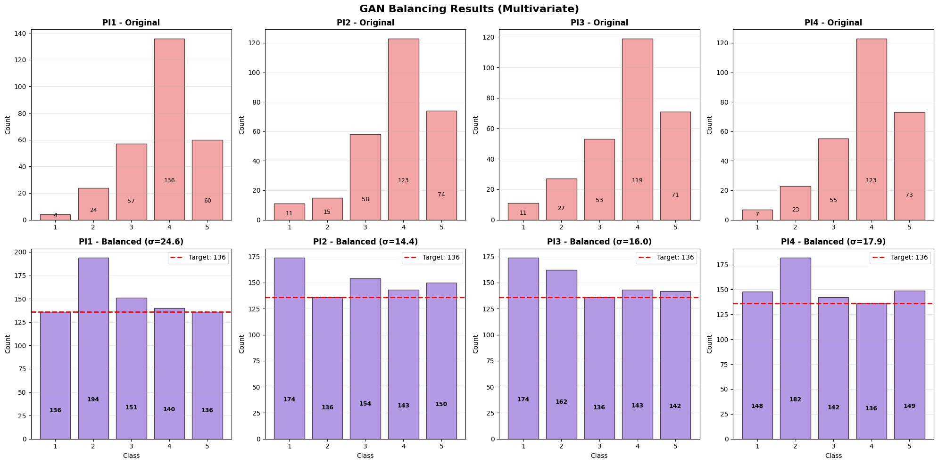

GAN: Synthetic Data
Generative Adversarial Networks, or GANs, are a cutting-edge technique for synthetic data generation.
Model | Accuracy | Precision | Recall | F1 Score
PI1 | 0.693 | 0.693 | 0.693 | 0.693
PI2 | 0.601 | 0.601 | 0.601 | 0.601
PI3 | 0.675 | 0.675 | 0.675 | 0.675
PI4 | 0.680 | 0.680 | 0.680 | 0.680
Model | Accuracy | Precision | Recall | F1 Score
PI1 | 0.745 | 0.745 | 0.745 | 0.745
PI2 | 0.632 | 0.632 | 0.632 | 0.632
PI3 | 0.592 | 0.592 | 0.592 | 0.592
PI4 | 0.508 | 0.508 | 0.508 | 0.508
11/ 13
Notes:
Generative Adversarial Networks, or GANs, are a cutting-edge technique for synthetic data generation. They consist of two neural networks—a generator and a discriminator—competing to produce samples indistinguishable from the real data. When applied to balancing imbalanced classification tasks such as purchase intention prediction, GANs generate new minority class rows that help address class imbalance.
With the simple approach, GAN-generated samples often lead to moderate performance improvements, but like other methods, can suffer from redundancy, distributional artifacts, and inflated class combinations if synthetic samples are not carefully targeted.
However, as with SMOTE and KNN, the complex, task-specific strategy—creating a separate balanced dataset for each PI variable—yields far better results. In practice, complex GAN balancing produces more realistic minority samples, achieving higher accuracy, recall, precision, and F1. It preserves the multidimensional relationships within the data, improves minority class detection, and helps unlock stronger generalization for our Bayesian network models.
While GANs typically require larger datasets and careful parameter tuning, their flexible modeling of feature distributions makes them valuable for improving fairness and robustness in multi-target consumer analytics. GANs—Generative Adversarial Networks—offer an advanced solution for synthetic data generation. The algorithm relies on two neural networks: a generator, which creates synthetic samples, and a discriminator, which judges whether samples are real or fake. Through their competition, GANs can mimic complex relationships and distributions in tabular data.
Our results show interesting trends. Using the simple approach, where all GAN-generated samples are merged, accuracy (0.662) and precision (0.681) are moderate—similar to KNN and SMOTE, but the models still struggle with data duplication and unrealistic class combinations.
Contrary to other methods, with GAN balancing, the complex, task-specific approach did not yield better performance. Metrics actually declined: average accuracy dropped to 0.619, and F1 to 0.615. This suggests that GANs, while powerful for generating realistic isolated samples, may struggle when splitting class-balancing tasks across multiple correlated outcome variables, especially with small datasets.
In summary, GANs are a promising tool but require careful architecture and more data to outperform simpler methods in multi-target retail analytics. Their advanced structure can sometimes overfit or misrepresent joint feature distributions, which highlights the need for rigorous validation in practical deployments.

Slide 13
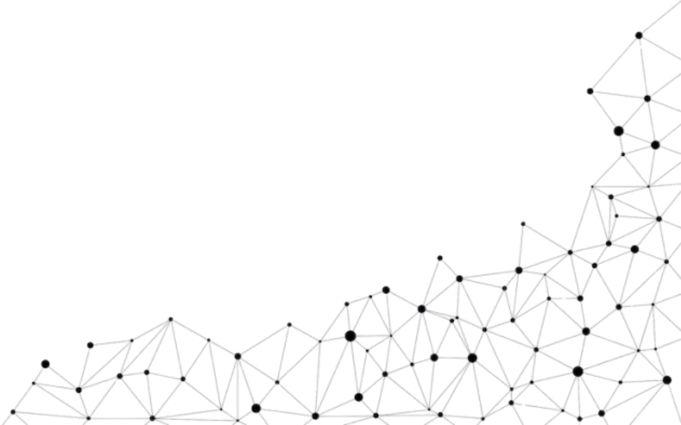
Model Comparison :
Method | PI1 Acc | PI2 Acc | PI3 Acc | PI4 Acc | Avg Acc | Std Dev Acc
Original | 0.753 | 0.624 | 0.647 | 0.765 | 0.697 | 0.062
SMOTE | 0.765 | 0.719 | 0.682 | 0.692 | 0.714 | 0.032
KNN | 0.819 | 0.751 | 0.754 | 0.778 | 0.776 | 0.027
GAN | 0.745 | 0.632 | 0.592 | 0.508 | 0.619 | 0.085
Method | PI1 F1 | PI2 F1 | PI3 F1 | PI4 F1 | Avg F1
Original | 0.757 | 0.643 | 0.663 | 0.761 | 0.706
SMOTE | 0.761 | 0.716 | 0.680 | 0.678 | 0.709
KNN | 0.816 | 0.748 | 0.751 | 0.770 | 0.771
GAN | 0.751 | 0.625 | 0.584 | 0.501 | 0.615
12/ 13
Notes:
This table summarizes all models on both Accuracy and F1 across PI1–PI4. KNN-based imputation consistently achieved the highest average accuracy (0.776) and F1 score (0.771), with the lowest variability—proving most robust and reliable for this dataset. SMOTE performed generally well, but not as highly as KNN. GAN, while promising theoretically, showed lower accuracy and greater variance, especially on PI4. The original, unbalanced data also performed surprisingly well in aggregate but struggled to recall minority classes. KNN offers the optimal balance between performance and realism, especially for predicting intentions for underrepresented customer groups. Interpretable models using realistic synthetic data, like KNN-balanced Bayesian Networks, provide trustworthy recommendations for retail decisions. SMOTE and GAN are less suited for this context due to either unrealistic samples or high computational cost. The original dataset, despite strong overall accuracy, cannot address fairness or minority class detection

Slide 14
Thank You
References:
Chawla, N.V., Bowyer, K.W., Hall, L.O. & Kegelmeyer, W.P., 2002. SMOTE: Synthetic Minority Over-sampling Technique. Journal of Artificial Intelligence Research, 16, pp. 321–357.
Goodfellow, I., Pouget-Abadie, J., Mirza, M., Xu, B., Warde-Farley, D., Ozair, S., Courville, A. & Bengio, Y., 2014. Generative Adversarial Networks. arXiv preprint arXiv:1406.2661.
Derks, E., et al., 2020. A Taxonomy of Explainable Bayesian Networks. Repository.up.ac.za.
Witpress, 2023. Modelling retail bank customers’ needs with Bayesian Belief Networks. WIT Transactions on Information and Communication Technologies, 54, pp. 161–172.
GeeksForGeeks, 2024. Differences Between Bayesian Networks and Neural Networks. [online] Available at: https://www.geeksforgeeks.org/differences-between-bayesian-networks-and-neural-networks/.
Shelf.io, 2024. Bayesian Neural Networks Minimize Uncertainty in Your AI. [online] Available at: https://shelf.io/blog/bayesian-neural-networks/.
Zulu, S., & Nkuna, N., 2022. Data modelling of subsistence retail consumer purchase behaviour in South Africa. Data in Brief, 43, 108453.
Group 4, 2025. Bayesian Networks and Synthetic Data Generation for Subsistence Retail Analytics. EDAB6808 Assignment Two, University of the Free State.
Research-Questionnaire_Subsistence-Retail-Consumer.pdf, 2022. Subsistence Retail Consumer Purchase Intention Questionnaire.
13/ 13

